Slide 1
Lecture 2 Review Linear Algebra & Ways of Geometric Thinking
Math 142
Professor Gu

Slide 2
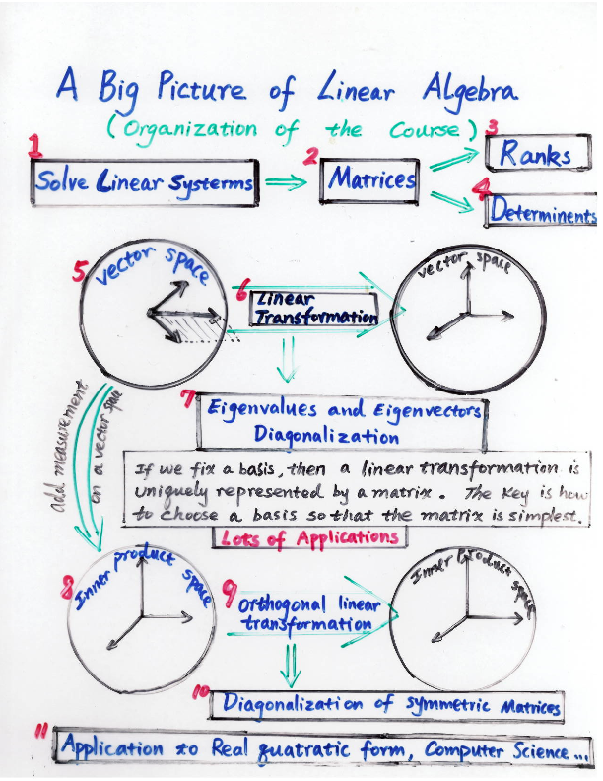

Slide 3
Please think each topic you learned in linear algebra geometrically.
For examples:
Solving linear system
Determinant
Vector Space
Linear transformation
Eigenvalues and Eigenvectors
Inner product

Slide 4
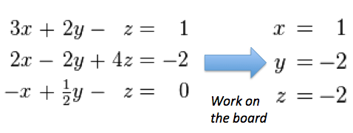

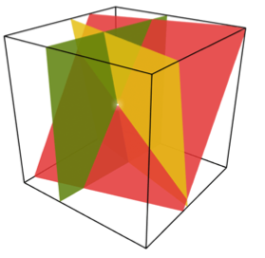
Geometric meaning of solving linear system

Slide 5
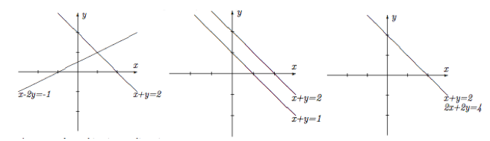
What kind of solutions that a linear system of two variables could have?

Slide 6
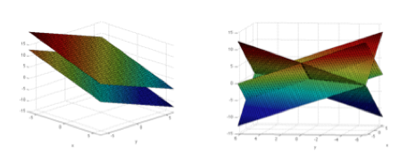
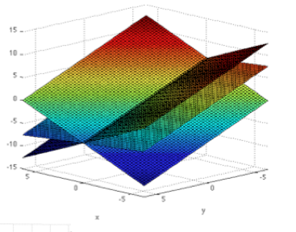
What kind of solutions that a linear system of three variables could have?
Key: Understand the solution space geometrically.

Slide 7
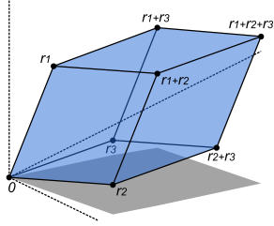
Understand the geometry of determinant of a matrix
The volume of this parallelepiped is the absolute value of the determinant of the matrix formed by the rows constructed from vectors r1, r2, and r3.

Slide 8
True or False
A linear system could have 3 solutions.
n+1 vectors in R^{n} must be linear dependent.
Determinant of n linearly dependent vectors must be equal to zero.

Slide 9
What will happen if the following matrix applying to a vector in R²?
1
-1 1

Slide 10
Does this matrix has real eigenvalues? Is it diagonalizable?
Answer:
How about the following matrix:
1 a
0 1

Slide 11
Matrix representation
Given a matrix A.
Go to the board and list all possible ways that this matrix A can represent.
E.g. The matrix A could represent a quadratic form as we saw from last class.

Slide 12
Can the following matrix be used to define an inner product?
3 1
1 3
Or
2
1

